Slide 1


CompSci club
User Input and Conditionals
Woo! Hopefully this is where you guys can really see yourself making some cool programs!

Slide 2
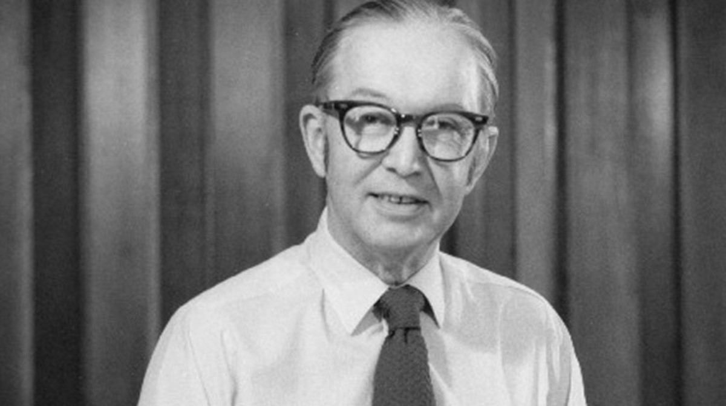
Our person of the day!
William Higinbotham
With a career that is odd as it is interesting, William Higinbotham is an American physicist that had an ever-lasting effect on both warfare and entertainment
Higginbotham and his team created the ignition device for the nuclear bomb during WWII, along with devices for the measurement
In 1947, as apart of the Brookhaven National Laboratory, he created a computer game called Tennis for Two
The game utilizes a oscilloscope for the display and two custom aluminum controllers
It was created for the Laboratory’s annual exhibition, and during the exhibition’s three days, it was extremely popular, especially with high school students
The following year, Tennis for Two exhibited again that added gravity
From Minecraft to GTA, we can thank Mr. Higginbotham and his partner, Robert Dvorak Sr.!
Developer of the first Nuclear Bomb
Grandfather of Video Games

Slide 3
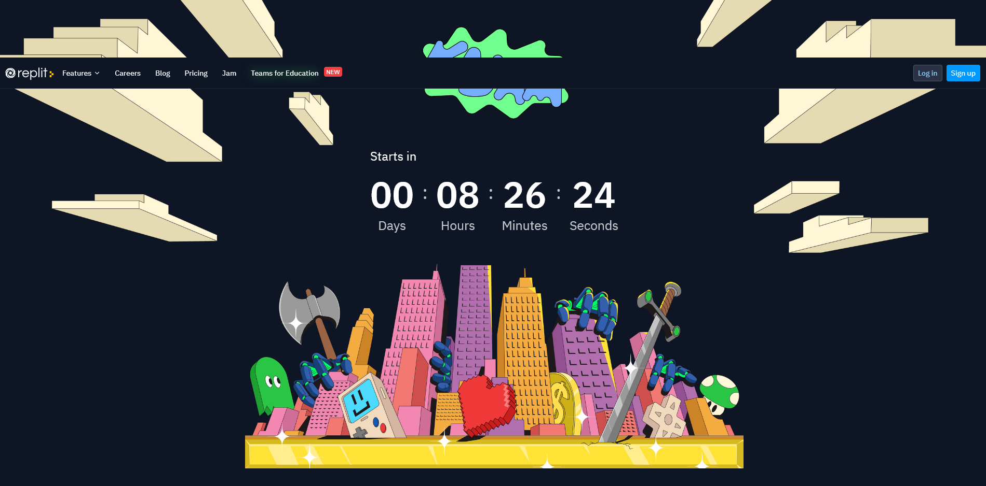
Opportunities Board
Repl.it, is holding a game design contest where you could win $10,000!
You don’t have to an amazing programmer at all; Categories where you could win $1,000 include Most Creative, Most Hilarious and Best Story
Repl.it has their own JavaScript library called Kaboom, with tutorials to learn the library
On top of that, they have multiple other tutorials to get started
As of today, it is live and the theme is announced, and you all have 7 days to work on the game
Visit https://replit.com/site/kajam to learn more!

Slide 4



Roadmap for Today
F-String formatting
A really easy, and Arnav’s personal favorite way to add variables to print statements
User Input
Programs are rarely just the code itself. Let’s make it more interactive!
Intro to Conditionals
Conditionals are the basis of a lot of the logic in programming. They are so useful!
Notes:
Ask what Github is and what version control is

Slide 5
A one slide introduction in this way to format strings!
F-String
Formatting

Slide 6
What in the world are F-Strings?
name1 = "Kim"
name2 = "Kardashian"
print(name1 + " " + name2) #Kim Kardashian
When you add things to a list, you might be familiar with just using the plus sign as shown on the right
However, do you see how we have to add that annoying empty string in between to add a space?
print(name1,name2) #Kim Kardashian
Some of might you use commas instead, which is also great
Just an alternative way to show all of this is using F-Strings
By putting an f before we start our string, and putting whatever variable inside curly brackets, we get the same result!
It’s all personal opinion, but this makes separation variables and text easier!
For those who might be familiar with older Python versions, this replaces % formatting and .format()
print(f"{name1} {name2}")
Notes:
An in depth explanation of formatting in python and its history! https://realpython.com/python-f-strings/

Slide 7
By the end of this section, you’ll be able to get information from your user!
Let’s look at
USer Input

Slide 8
An Overview of User input
input("YOUR QUESTION")
You might be wondering what the term ‘User Input’ even means
Well, all it describes is asking our user (the person using the program) for some information
This can be pressing a button, completing a task, but for our purposes in the Python terminal, it is going to be asking them to type something in
To get an input, use the input() function, and pass your question into the parentheses!
When we ask a user for an input, no matter what they type in, it will always come back as a string
This might create some problems if we want to use the input for things like addition
If you want to convert an input to another data type, use the following built-in functions
Str() - Converts what you pass into a string
Int() - Converts into an integer
Float() - Converts into a float
first_user_input = input("What is your name? ") #Arnav
print(f"Hello {first_user_input}!") #Hello Arnav!
favorite_number = int(input("What is your favorite number? ")) #11
favorite_number_plus_10 = print(f"Your favorite number plus 10 equals {favorite_number + 10}")
#Your favorite number plus 10 equals 21

Slide 9
More examples of User input
number = float(input("What number would you like to cube? ")) #10.1821
print(f"{number} cubed is {number ** 3}") #10.1821 cubed is 1055.630850810661
multiple_of_13 = int(input("Name a multiple of 13 ")) #234
print(f"13 times {multiple_of_13 / 13} equals {multiple_of_13}") #18
income = float(input("How much money do you make? $")) #53,703
print(f"In North Carolina, after taxes, you would have ${round(income * .9475, 2)}")
#In North Carolina, after taxes, you would have $50883.59
favorite_movie = input("What is your favorite movie? ") #Curious George
favorite_movie_year = int(input(f"When was {favorite_movie} released? ")) #2006
print(f"{favorite_movie} was released {2021 - favorite_movie_year} years ago in {favorite_movie_year}")
#Curious George was released 15 years ago in 2006

Slide 10
This will be short, but gives us a good overview for the future!
An introduction to
Conditionals

Slide 11
What are Conditionals?
if SOME CONDITION:
# Run this block of code
else:
#Run this block of code instead
In programming, it is infrequent that we just take information the user inputs and just spit it back at them
Usually, given what the user gives us or some other condition, we want to check if something is True or False, and then display something
For example, in our previous income example, what a person’s income was above a certain number and they had to pay higher taxes? We would want to check for that!
That is where if statements come into play!
They allow us to specify a condition and if that condition is true, we run a block of code
Using the else statement, if the condition isn’t true, we can tell our program to run something else!
If statements look a bit different in every language, but on the right is how they look in Python!
number = 12
if number > 11:
print("Number is above 11!")
else:
print("Number is below 11!")
name = input("What is your name? ")
if name == "Arnav" or name == "Fillip":
print("You are a CompSci leader!")
else:
print("You are not a CompSci leader!")

Slide 12
More complex Conditionals
if SOME CONDITION:
# Run this block of code
elif SOME OTHER CONDITION:
# Run this block of code if that is true!
elif SOME OTHER OTHER CONDITION:
# We can have as many elifs as we want!
else:
#If nothing is true, run this at the end
Usually we just don’t want a ‘yes’ or ‘no’ program; In other words, what if there are more conditions beside the one we specify in the if statement?
That is where elif comes into play!
Just like if, if we pass a condition into elif, we can specify another condition and another block of code if the if statement returns False
With elif, we can have an else statement as well that acts like a ‘catch all’ that runs if all of the conditions we pass in return false
With if statements, it’s good to think about going from most specific to least specific
Our if statement will be the first thing to run, so if we want to check for something very specific, we would want to do it first!
name = input("What is your name? ")
if name == "Arnav" or name == "Fillip":
print("You are a CompSci leader!")
elif name in ["Ian", "Gabe", "Tushar"]:
print("You are a CompSci member!")
else:
print("You are not in CompSci!")

Slide 13
If we have extra time, or you want some practice, here it is!
Bonus! Practice with
Conditionals & Inputs

Slide 14
Problem Set One
Exercise One:
Copy the code from the income example on Slide 9
This is a major oversimplification, but here are the federal income tax brackets
$0 to $9,875 - 10%
$9,876 to $40,125 - 12%
$40,126 to $85,525 - 22%
$85,526 to $163,301 - 24%
$163,301 to $207,350 - 32%
$207,351 to $518,400 - 35%
$518,401+ - 37%
Create a program that asks the user for their income, and then applies the correct federal income tax and then the NC income tax on that (assume state taxes come after federal taxes)
Make sure to use the and keyword and greater than and less than operands!

Slide 15
If you have any questions at all, please don’t hesitate to stay back or email one of us!
Thank you!
That is all we have for today!

